Slide 1
Segmentation and Recognition of Handwritten text
K.S.S.Bhargav
CS15B015

Slide 2

Challenges
Noise in the image makes it difficult to separate out the letters.
Different styles of writing the same letter. Eg: f, f.
Finding letter boundaries in cursive handwriting. Eg: ’W’ can be segmented into two ‘V’s
A single algorithm doesn’t work in all cases.

Slide 3
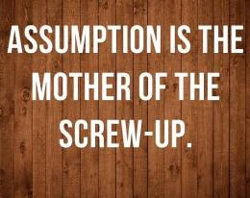
Assumptions
Little noise in the Images.
All components of a single letter are connected.
Block letters and no cursive handwriting.

Slide 4
The Pipeline
Preprocessing
Letter
Segmentation
Recognition

Slide 5
Preprocessing
Image is read as a grayscale image and segmented using thresholding
Bitwise not of the binarized image is taken.

Slide 6

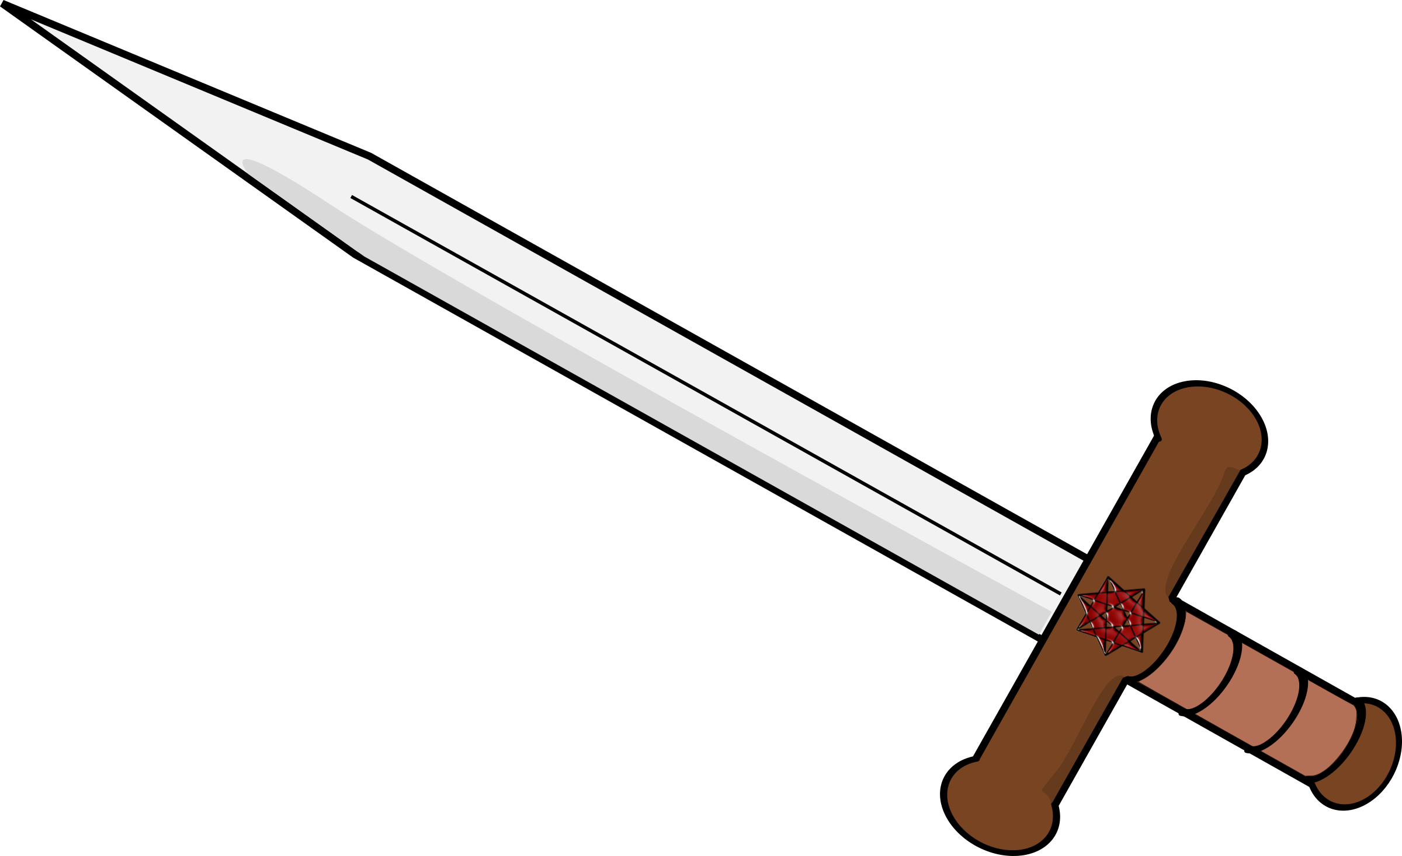
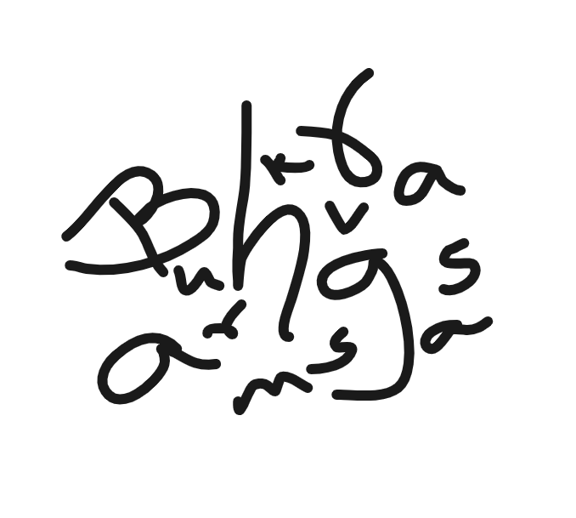













Letter Segmentation

Slide 7
Hoshen Kopelman algorithm.
Segments the connected components of the image.
The algorithm scans through each pixel of the image and labels it with the minimum value amongst already passed neighbors and then calls a union op.
2 | 2 | 2
3 | 2 | 25
23 | 54 | 56

Slide 8
Recognition

Slide 9
CNN Architecture
Input
layer
Conv
layer1
Max
Pool
1
Conv
layer2
Max
Pool
2
Fully
Connect
Output
layer
Flatten
2X2
72, 3x3
S =2
2X2
30X30
36, 3x3
S =1
256

Slide 10
ReLU activations at the end of each convolutional layer and the fully connected layer.
Softmax layer at the end of output layer.
Optimizer - Adam
Loss - Categorical cross entropy

Slide 11

Dataset
EMNIST
550 images each class for the training set.
50 images each class for validation set.
14 classes of images. ( For Now )

Slide 12

Results:
99.7% on the training set.
99.02% on the validation set.

Slide 13

Demo time!

Slide 14

Future Improvements
Robust noise removal mechanism.
Extending to cursive writing by skeletonizing and segmenting at prospective letter boundaries.
Using RNN for cursive handwriting.

Slide 15
Thanks!
Any questions?

